Slide 1


Olfactory Odor Source Localization Robot Using Deep Neural Networks
JA
Graduate Research Project
GRP- Summer 2022
By:
Mohammed Alajaji

Slide 2
Agenda
Warm-up
Introduction
Machine Learning (ML)
Deep Neural Network (DNN)
Convolutional Neural Network (CNN)
Recurrent Neural Network (RNN)
Transfer Learning (TL)
Data
Project Development
Data Preprocessing
Model Training
Results
Conclusion

Slide 3
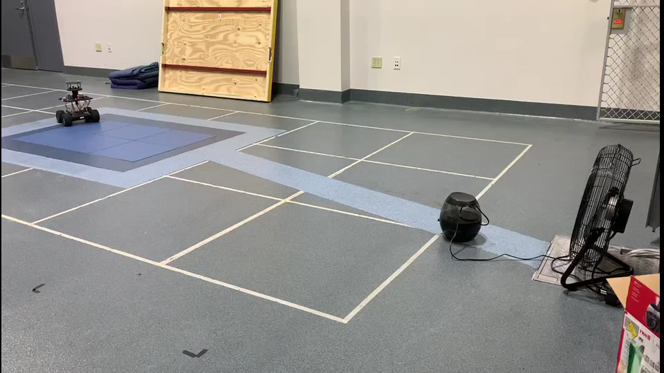
Warm-up

Slide 4

Introduction
Robotics
Mimics human or animal behaviors.
Can be used in dangerous situations or in situations that humans or animals are not able to achieve.
Perceives the world as a human does, with sight, smell, touch, taste, and hearing.
Smell has not been sufficiently exploited in mobile robotics as the other senses.

Slide 5
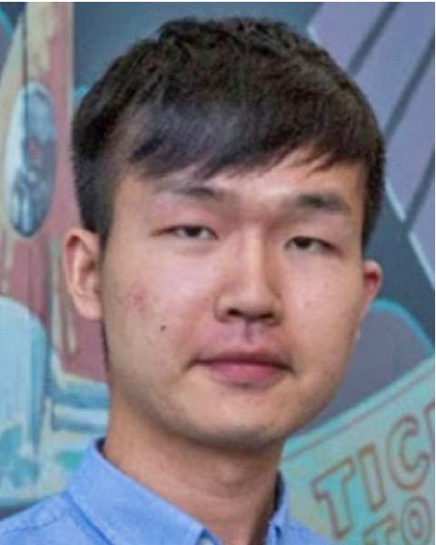
Introduction
Odor source localization (OSL) robot
Was designed and constructed by Dr. Lingxiao Wang during his PhD research.
Used different algorithms to trace and locate a plume and localize the chemical source.
Was tested in real-world experiments.

Slide 6
Introduction
Robot
.
.
.
Sensors
ML Algorithm

Slide 7
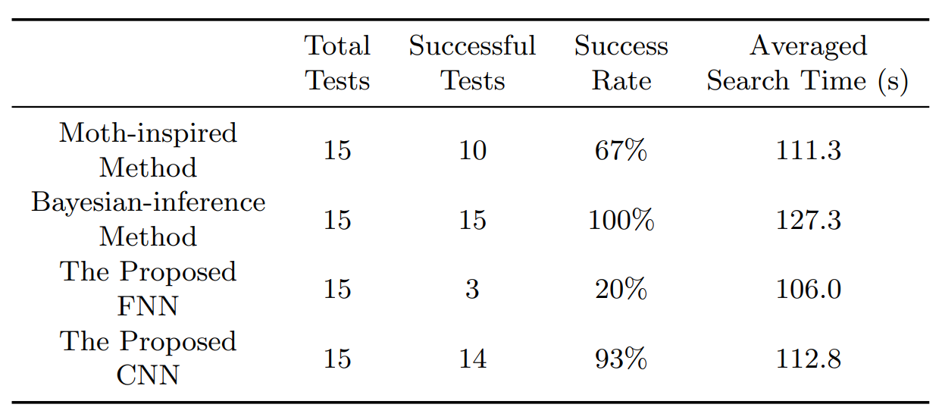
Introduction
This Project is a continuation of Dr. Lingxiao Wang’s work.
It focuses on Machine Learning – Deep Neural Network (DNN).
Notes:
To investigate the generalization of the proposed DNN models, they are implemented in OSL tests with di↵erent search conditions, including varying robot initial positions, odor source locations, and environmental settings.

Slide 8
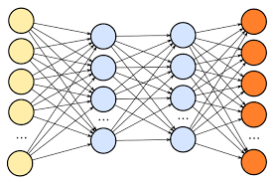
Introduction
CNN is preferable for two reasons:
The query time of the machine learning model is predictable and unaffected by the size of the search area.
It can learn other successful navigation methods from demonstrations with explicating specific search algorithms.
In this project, CNN and RNN are implemented to produce robot commands

Slide 9
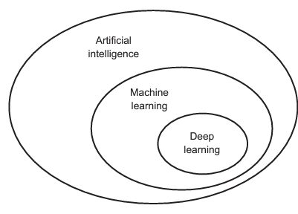
Machine Learning - ML
ML has become the most popular and successful subfield of artificial intelligence.
Deep learning is the fastest-growing and the most significant subfield of machine learning.

Slide 10
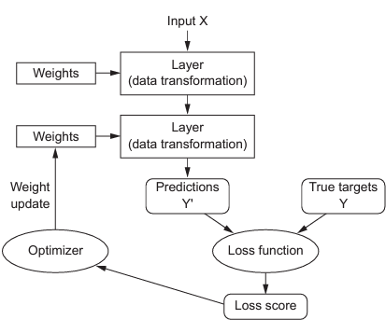
Deep Neural Network - DNN
DNN has different models that serve various applications in different sectors nowadays.
DNN structure:

Slide 11
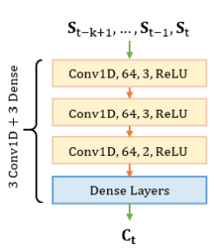
CNN
Suitable for forecasting time-series.
Used for learning an effective navigation strategy and applying the learned knowledge to new environments.
Preference for implementation to real-world applications due to the predictable query time.
Fixed computational cost

Slide 12
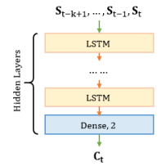
RNN
Powerful for modeling sequence data such as time series.
LSTM is an extension of RNN, which basically extends the memory.
LSTMs are used as the building blocks for the layers of RNN.
LSTMs assign data “weights” which help RNNs to either allow the input of new information, forget information, or assign it sufficient importance that can impact the output.

Slide 13
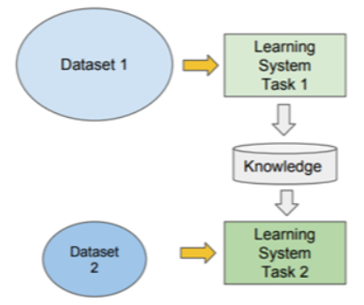
Transfer Learning - TL
TL enables us to utilize knowledge from previously learned tasks and apply them to newer, related ones.
The reason for using TL in this project is due to the lack of real data.
The learning process in TL can be faster, more accurate and/or require less training data.

Slide 14
Data
The data is the main component for the success of the machine learning models.
DNN needs as much data as possible to avoid overfitting and underfitting problems.
OSL robot data
The OSL robot data was collected by Dr. Wang during his PhD research.
Two types of OSL robot data are available: real data and simulated data.
Only 120 samples of real data were collected
6000 samples of computer simulated data were collected
Three different methods were used to collect the data, namely moth-inspired, Bayesian-inference, and fusion methods.
Notes:
because it is costly and time-consuming.

Slide 15
Data Collecting
Moth-inspired data was collected by mimicking the mate-seeking behaviors of the male moth.
Bayesian-inference is an engineering-based method.
Fusion data is a combination of the moth-inspired and Bayesian-inference methods
Dataset
Computer Simulated Data
Real Data
Fusion Data (6000)
Moth-inspired Data (6000)
Bayesian-inference Data (6000)
Moth-inspired Data (120)
Bayesian-inference Data (120)
Fusion Data (120)

Slide 16
Project Development
The core idea of the project is to train a DNN model to provide accurate commands to the OSL robot to localize the odor source.
Project development steps:
Data preprocessing
Model training
Real-world test

Slide 17
Data Preprocessing
Data preprocessing is a data mining technique used to turn the raw data into a format that is practical and effective.
Data preprocessing is very important part to convert the raw data into a well-readable format.
Data preprocessing consists of
Dropping missing, inconsistent, and noisy values.
Combining two or more features
Reordering
Normalization

Slide 18
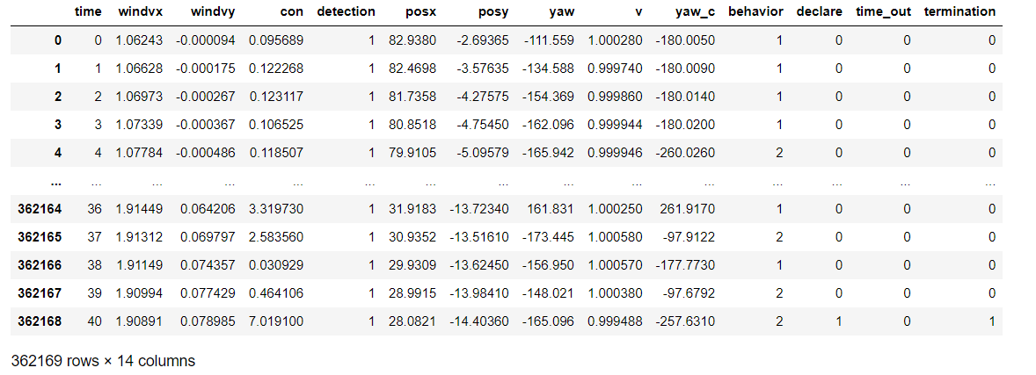
Data Preprocessing
Data preprocessing steps:
visualize the raw moth-inspired data (Computer simulated data).

Slide 19
Data Preprocessing
The raw data has 13 Features:
time (s) | It records the time in seconds from trail starts 0s until it ends 400s ≤.
windvx (m/s) | Wind velocity in x-axis direction.
windvy (m/s) | Wind velocity in y-axis direction.
con (mmpv) | Chemical concentration in the robot position
detection (1 or 0) | 1 when detecting a plume and 0 otherwise.
posx (m) | Robot position in x-axis
posy (m) | Robot position in y-axis
yaw (deg) | Robot heading angle
v (m/s) | Robot speed
yaw_c (deg) | Robot heading command
behavior | The robot’s behaviors (finding, tracing, tracking, …, etc.)
declare (1 or 0) | declare = 1 the robot reaches the odor source and 0 otherwise.
time_out (1 or 0) | 1 when the time reaches 400 s
termination (1 or 0) | Terminate the robot in two cases declare the odor source or the trials time = 400 s

Slide 20
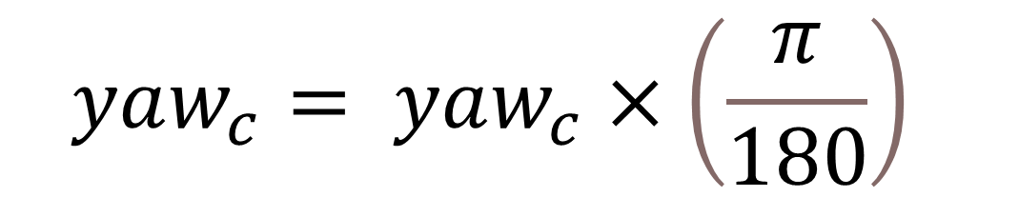
Data Preprocessing
2. Drop all the empty cells.
3. Drop unnecessary features ('declare’, 'termination’, 'time_out’, 'time’, 'posx’, 'posy’, 'yaw’, ‘v’, 'behavior').
5. Convert the robot heading commands “yaw_c” from negative values into positive by adding 360° to each element.
6. Convert the robot heading commands “yaw_c” from degree to radians.
$$yaw_{c}= yaw_{c}×\left(\frac{π}{180}\right)$$

Slide 21
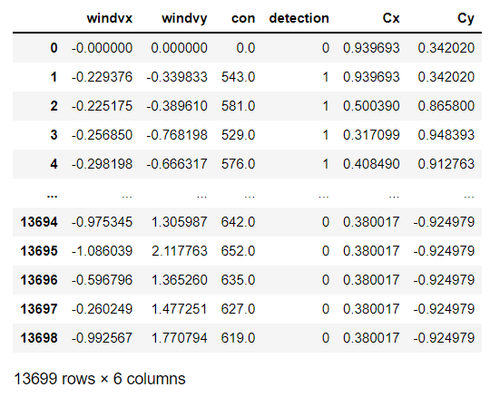
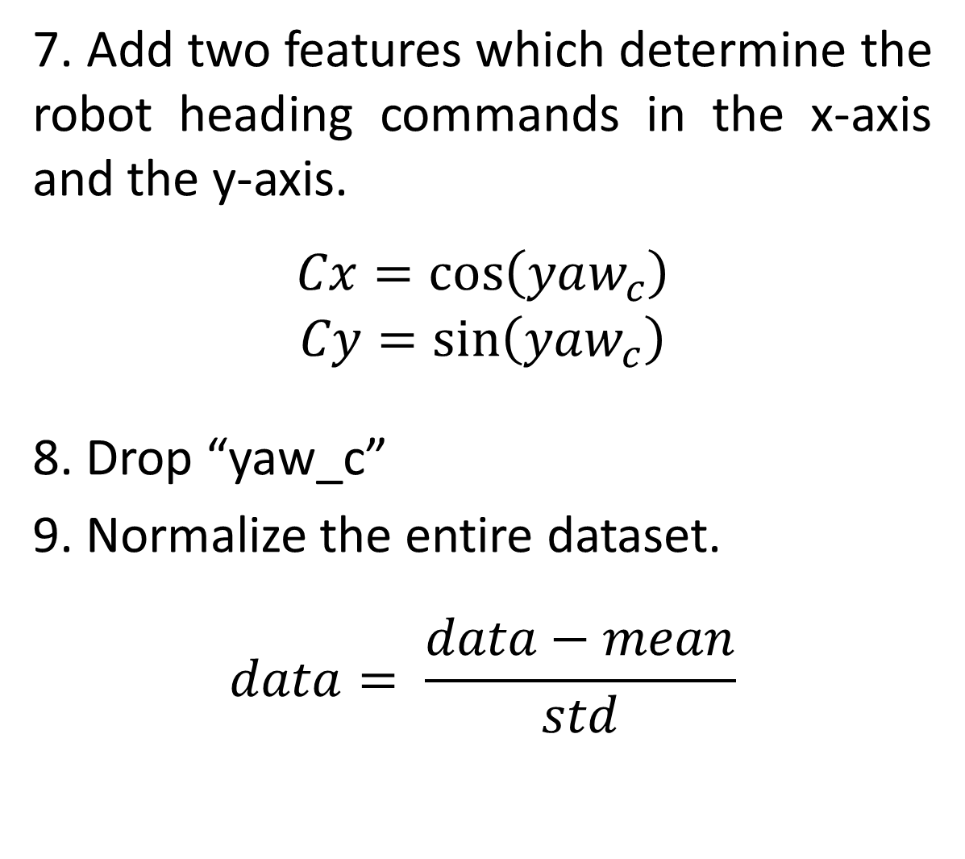
Data Preprocessing
7. Add two features which determine the robot heading commands in the x-axis and the y-axis.
$$Cx=\cos\left(yaw_{c}\right)$$
$$Cy=\sin\left(yaw_{c}\right)$$
8. Drop “yaw_c”
9. Normalize the entire dataset.
$$data= \frac{data−mean}{std}$$

Slide 22
Model Training
1. Split the datasets into three sets:
80% Training set.
10% Validation set.
10% Test set.
2. Define a time series window generator that can handle the indexes and offsets and divide the windows of features into (feature, labels) pairs.
3. Define a compile:
Metrics: Mean Absolute Error (MAE)
Loss function: Mean Square Error (MSE)
Optimizer: Adam Optimizer

Slide 23
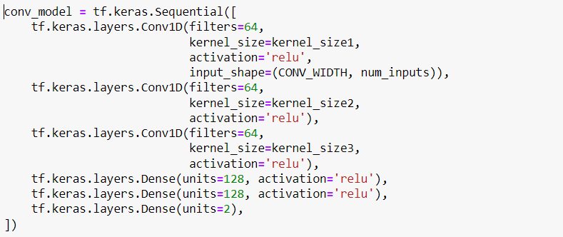
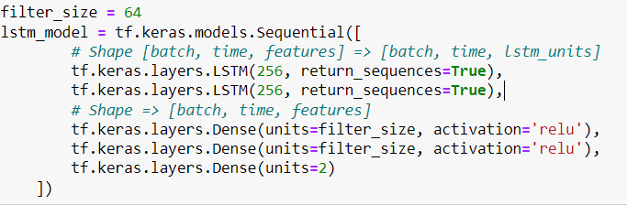
Model Training
4. Define the model:
CNN
RNN

Slide 24
Model Training
5. Train the model using simulated data.
6. Implement TL
Freeze the pre-trained CNN or RNN model layers
Add new trainable layers (2 dense layers)
Train the new layers
Fine tune the model

Slide 25
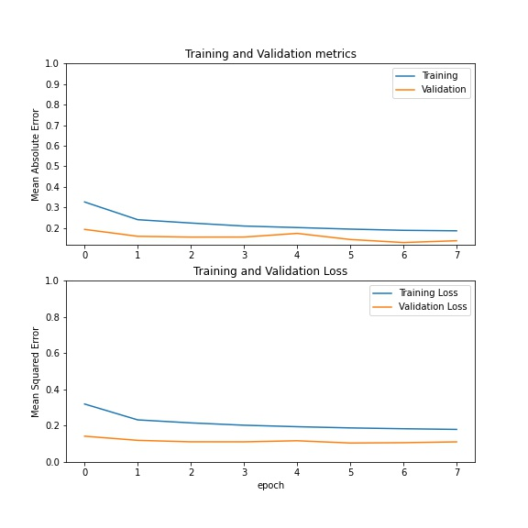
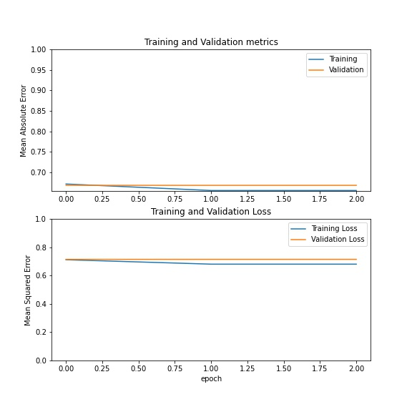
Results
Moth-inspired Data:
Transfer Learning
(RNN pre-training model)
RNN-Real Data

Slide 26
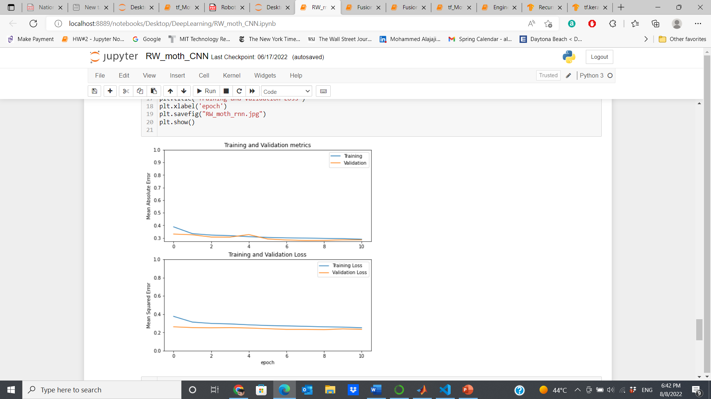
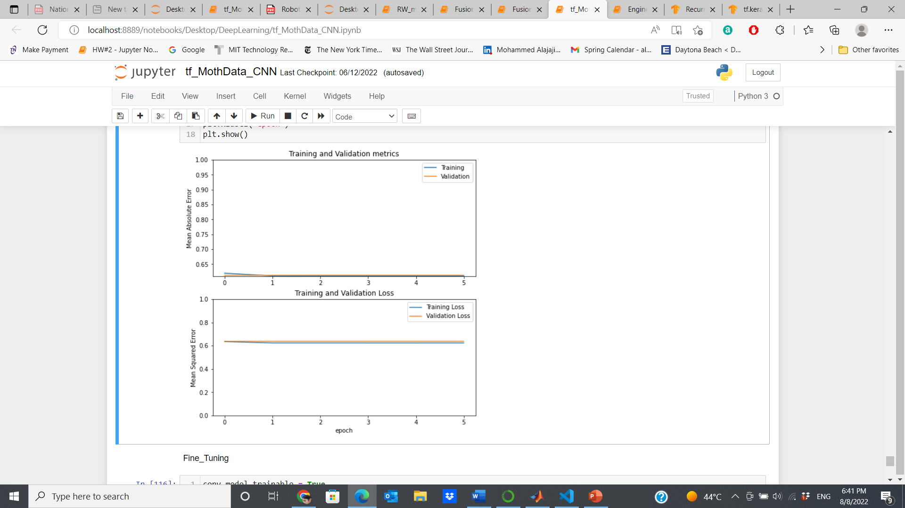
Results
Moth-inspired Data:
Transfer Learning
(CNN pre-training model)
CNN-Real Data

Slide 27
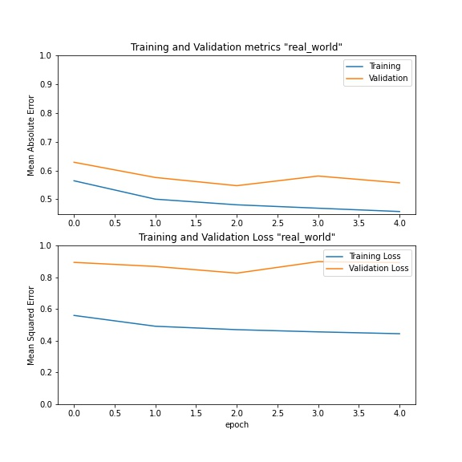
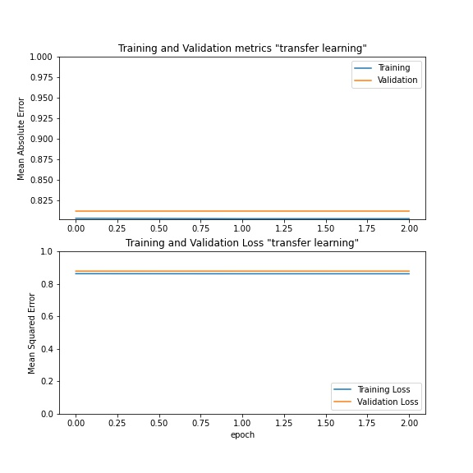
Results
Bayesian-inference Data:
Transfer Learning
(CNN pre-training model)
CNN-Real Data

Slide 28
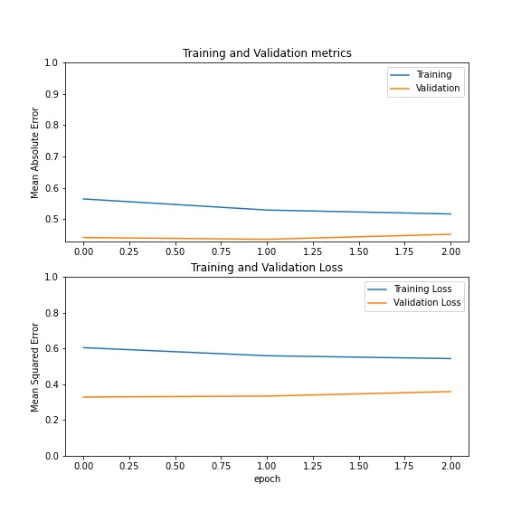
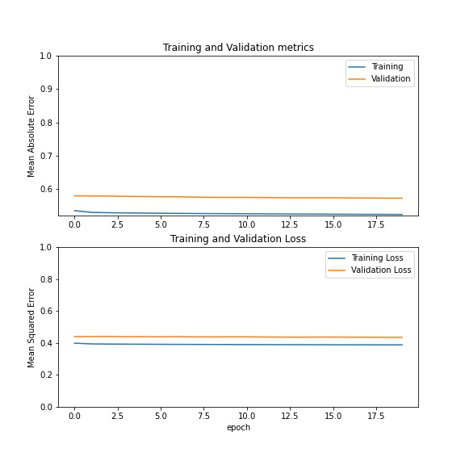
Results
Fusion Data:
Transfer Learning
(CNN pre-training model)
CNN-Real Data

Slide 29
Results
Bayesian-inference Data:
Transfer Learning
(RNN pre-training model)
RNN-Real Data

Slide 30
Results
Fusion Data:
Transfer Learning
(CNN pre-training model)
RNN-Real Data

Slide 31
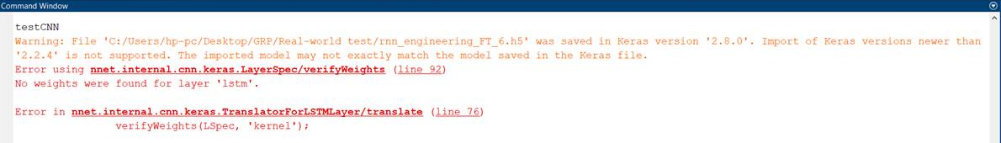
Conclusions
The OSL robot is a very challenging.
CNN and RNN models using real data show very weak generalizations.
TL is implemented to train the model using the knowledge of the pre-trained model.
Transfer learning achieves better performance.
The real-world experiments are supposed to be conducted as one of the project deliverables.
An issue of calling the DNN model file (.h5) in MATLAB code.
Run-out of time
Notes:
and it needs to take many variables into account such as the environment, and the search algorithms.
due to the lack of OSL robot real data.
(CNN or RNN model) that used similar data to the real data.
in terms of model generalization

Slide 32
References
[1] Wang, L.. (2021). "Robotic Olfactory-Based Navigation with Mobile Robots". PhD Dissertations and Master's Theses. 623. https://commons.erau.edu/edt/623
[2] Chollet, F. (2018). Deep Learning with Python, Shelter Island, NY: Manning Publications Co.
[3] Recurrent Neural Networks (RNN) with Keras | TensorFlow Core. (2022). Retrieved 9 August 2022, from https://www.tensorflow.org/guide/keras/rnn
[4] tf.keras.layers.LSTM | TensorFlow Core v2.9.1. (2022). Retrieved 9 August 2022, from https://www.tensorflow.org/api_docs/python/tf/keras/layers/LSTM
[5] Sarkar, D. (2018), "Towards Data Science“. Retrieved 9 August 2022 from https://towardsdatascience.com/a-comprehensive-hands-on-guide-to-transfer-learning-with-real-world-applications-in-deep-learning-212bf3b2f27a.
[6] Time series forecasting | TensorFlow Core. (2022). Retrieved 9 August 2022, from https://www.tensorflow.org/tutorials/structured_data/time_series

Slide 33
JA
Thank you
Questions?
By:
Mohammed Alajaji

